Slide 1



Representation Learning of Text : Word Vectors
Anuj Gupta
Satyam Saxena
@anujgupta82, @Satyam8989
anujgupta82@gmail.com, satyamiitj89@gmail.com

Slide 2
Outline
Session 1
Introduction
Bigram model
Skip Gram model
CBOW model
Evaluation
Speed Up
Session 2
Glove
T-SNE
Secret Ingredients

Slide 3
Introduction
Example of NLP tasks :
Easy
Spell Checking
Keyword Search
Finding Synonyms
Medium
Parsing information from websites, documents, etc.

Slide 4
Hard
Machine Translation (e.g. Translate Chinese text to English)
Semantic Analysis (What is the meaning of query statement?)
Co-reference (e.g. What does "he" or "it" refer to given a document?)
Question Answering (e.g. Answering Jeopardy questions).
The first and arguably most important common denominator across all NLP tasks is : how we represent text as input to our models.

Slide 5
Machine does not understand text.
We need numeric representation
An integral part of any NLP pipeline.
Unlike images (RGB matrix), for text there is no obvious way.
Legacy Techniques*
Bag of words
N-gram
TF-IDF
* Details in appendix

Slide 6
Bottom Line
More often than not, how rich your input representation is has huge bearing on the quality of your downstream ML models.
For NLP, archaic techniques treat words as atomic symbols. Thus every 2 words are equally apart.
They don’t have any notion of either syntactic or semantic similarity between parts of language.
This is one of the chief reasons for poor/mediocre performance of NLP based models.
But this has changed dramatically in past few years

Slide 7

Distributional & Distributed Representations

Slide 8
Distributional representations
Linguistic aspect.
Based on co-occurrence/ context
Distributional hypothesis: linguistic units with similar distributions have similar meanings.
The distributional property is usually induced from document or context or textual vicinity (like sliding window).
Notes:
Revisit this slide
If M_{w,d} is the distributional input, then the goal is to reduce M_{w,d} into M_{w,k} where k << d while preserving the similarity.

Slide 9
Distributed representations
Compact, dense and low dimensional representation.
Differs from distributional representations as the constraint is to seek efficient dense representation, not just to capture the co-occurrence similarity.
Each single component of vector representation does not have any meaning of its own.
The interpretable features (for example, word contexts in case of word2vec) are hidden and distributed among uninterpretable vector components.
Notes:
Revisit this slide

Slide 10
Embedding: Mapping between space with one dimension per linguistic unit (word, character, phrase, sentence, document ) to a continuous vector space with much lower dimension.
“You shall know a word by the company it keeps” - J R Firth
One of the most successful ideas of modern statistical NLP
Notes:
Revisit this slide

Slide 11

Global Matrix Factorization

Slide 12
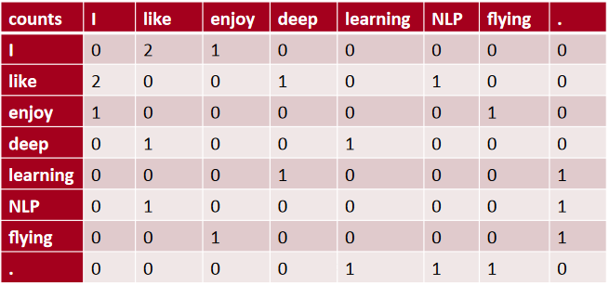
Co-occurrence with SVD
Define a word using the words in its context.
Words that co-occur
Building a co-occurrence matrix M.
Context = previous word and next word
Corpus ={“I like deep learning.”
“I like NLP.”
“I enjoy flying.”}

Slide 13
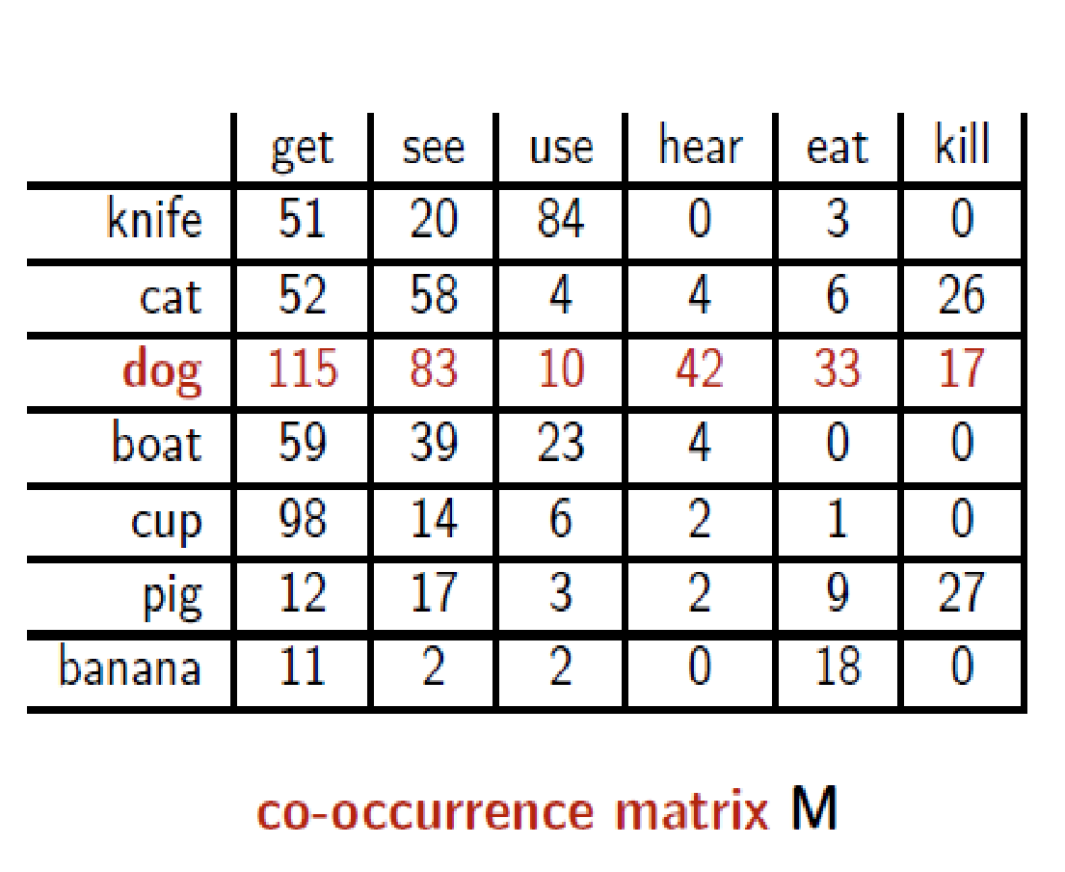
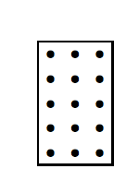
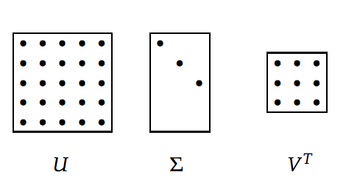
Imagine we do this for a large corpus of text
row vector x_{dog} describes usage of word dog in the corpus
can be seen as coordinates of point in n-dimensional Euclidean space R^{n}
Reduce dimensions using SVD
=
M

Slide 14
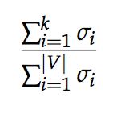
Given a matrix of m × n dimensionality, construct a m × k matrix, where k << n
M = U Σ V^{T}
U is an m × m orthogonal matrix (UU^{T} = I)
Σ is a m × n diagonal matrix, with diagonal values ordered from largest to smallest (σ₁ ≥ σ₂ ≥ · · · ≥ σ_{r} ≥ 0, where r = min(m, n)) [σ_{i}’s are known as singular values]
V is an n × n orthogonal matrix (VV^{T} = I)
We construct M’ s.t. rank(M’) = k
We compute M’ = U Σ’ V, where Σ’ = Σ with k largest singular values
k captures desired percentage variance
Then, submatrix U _{v,k} is our desired word embedding matrix.

Slide 15
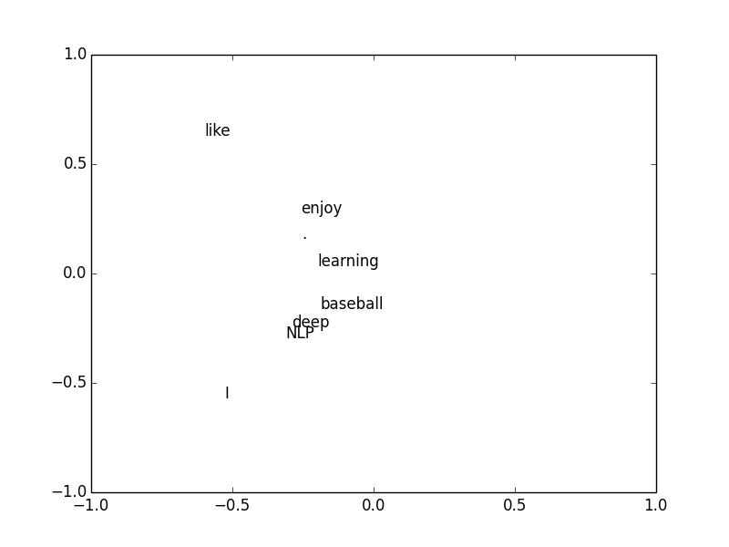
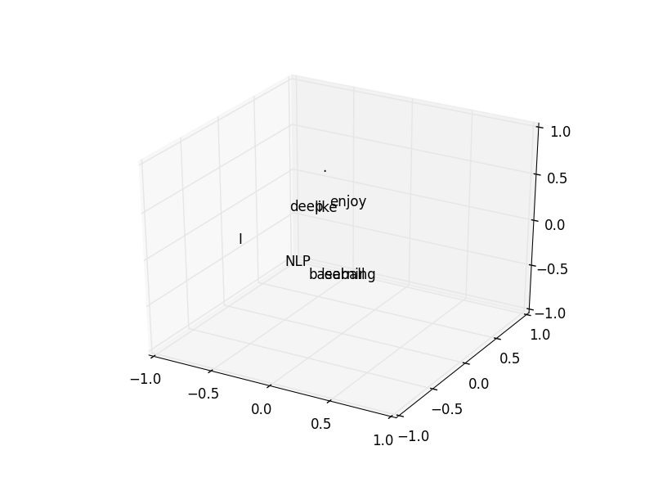
Result of SVD based Model
K = 2
K = 3

Slide 16
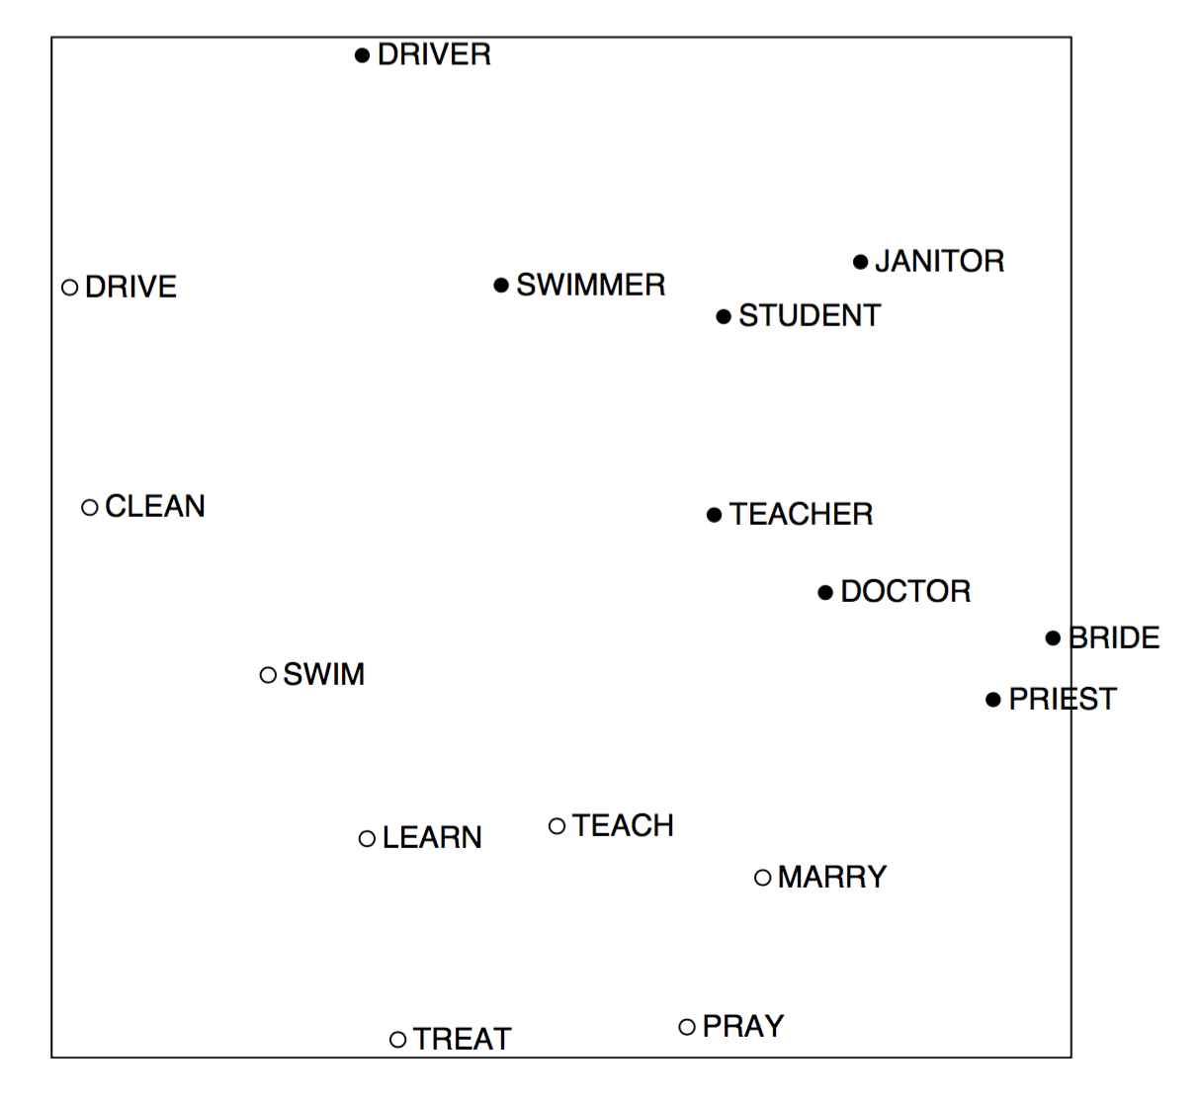
An Improved Model of Semantic Similarity Based on Lexical Co-Occurrence Rohde et al. 2005

Slide 17
Pros & Cons
+ Simple method
+ Captures some sense (though weak) of similarity between words.
Matrix is extremely sparse.
Quadratic cost to train (perform SVD)
Drastic imbalance in frequencies can adversely impact quality of embeddings.
Adding new words is expensive.
Take home : we worked with statistics of the corpus rather than working with the corpus directly. This will recur in GloVe

Slide 18
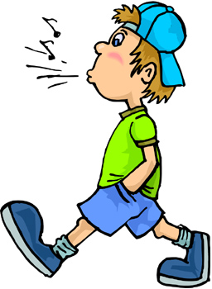
BiGram Model
Idea: Directly learn low-dimensional word vectors ?

Slide 19
Language Models
Filter out good sentences from bad ones.
Good = semantically and syntactically correct.
Modeled this via probability of given sequence of n words
Pr (w₁, w₂, ….., w_{n})
S₁ = “the cat jumped over the dog”, Pr(S₁) ~ 1
S₂ = “jumped over the the cat dog”, Pr(S₂) ~ 0

Slide 20
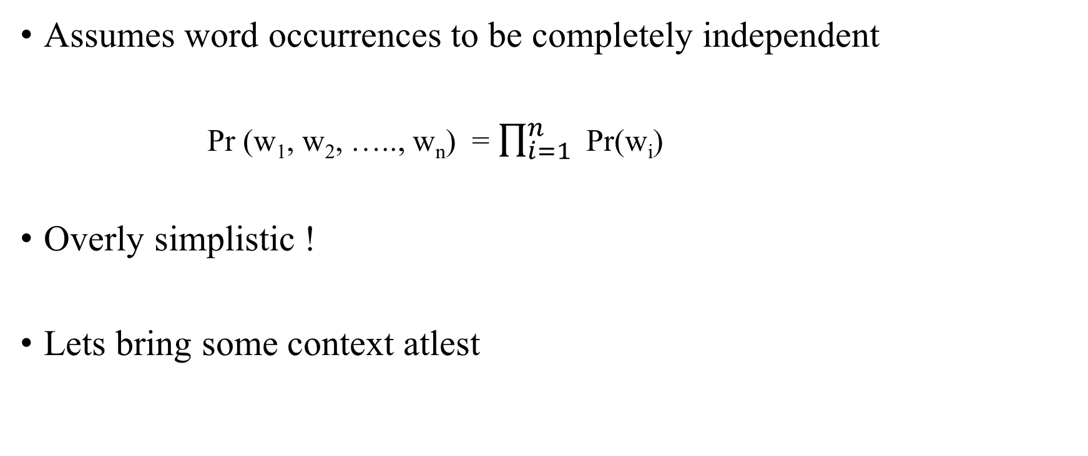
Unary Language Models

Slide 21
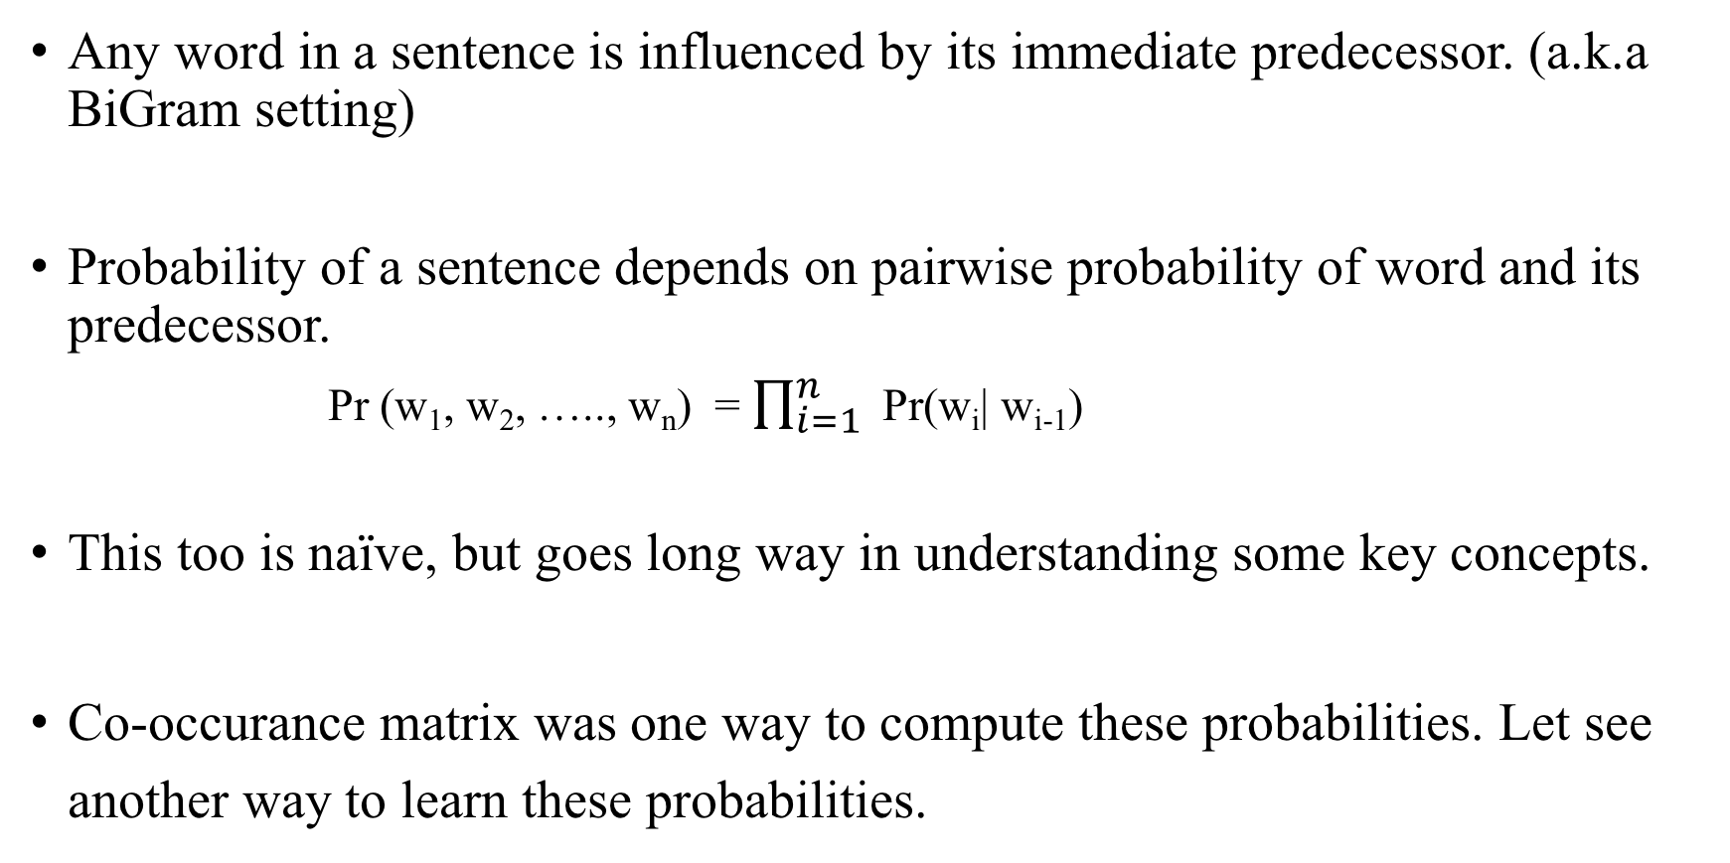
Binary Language Models

Slide 22
BiGram Model
Objective : given w_{i} , predict w_{i+1}
Training data: given sequence of n words < w₁, w₂, ….., w_{n} >, extract bi-gram pairs (w_{i-1} , w_{i})
Knowns:
input – output training examples : (w_{i-1} , w_{i})
Vocab of training corpus (V) = U (w_{i})
Unknowns: word embeddings. Model as a matrix E _{|v| x d} . d = embedding dimensions. Usually a hyper parameter.
Model : shallow net

Slide 23
Architecture
Embedding matrix
Scoring layer
Softmax layer
w_{i}
w_{i-1}

Slide 24
Steps
Feed index of w_{i-1} as input to network.
Use index to lookup embedding matrix.
Perform affine transform on word embedding to get a score vector.
Compute probability for each word.
Set 1-hot vector of w_{i} as target.
Set loss = cross-entropy between probability vector and target vector.

Slide 25
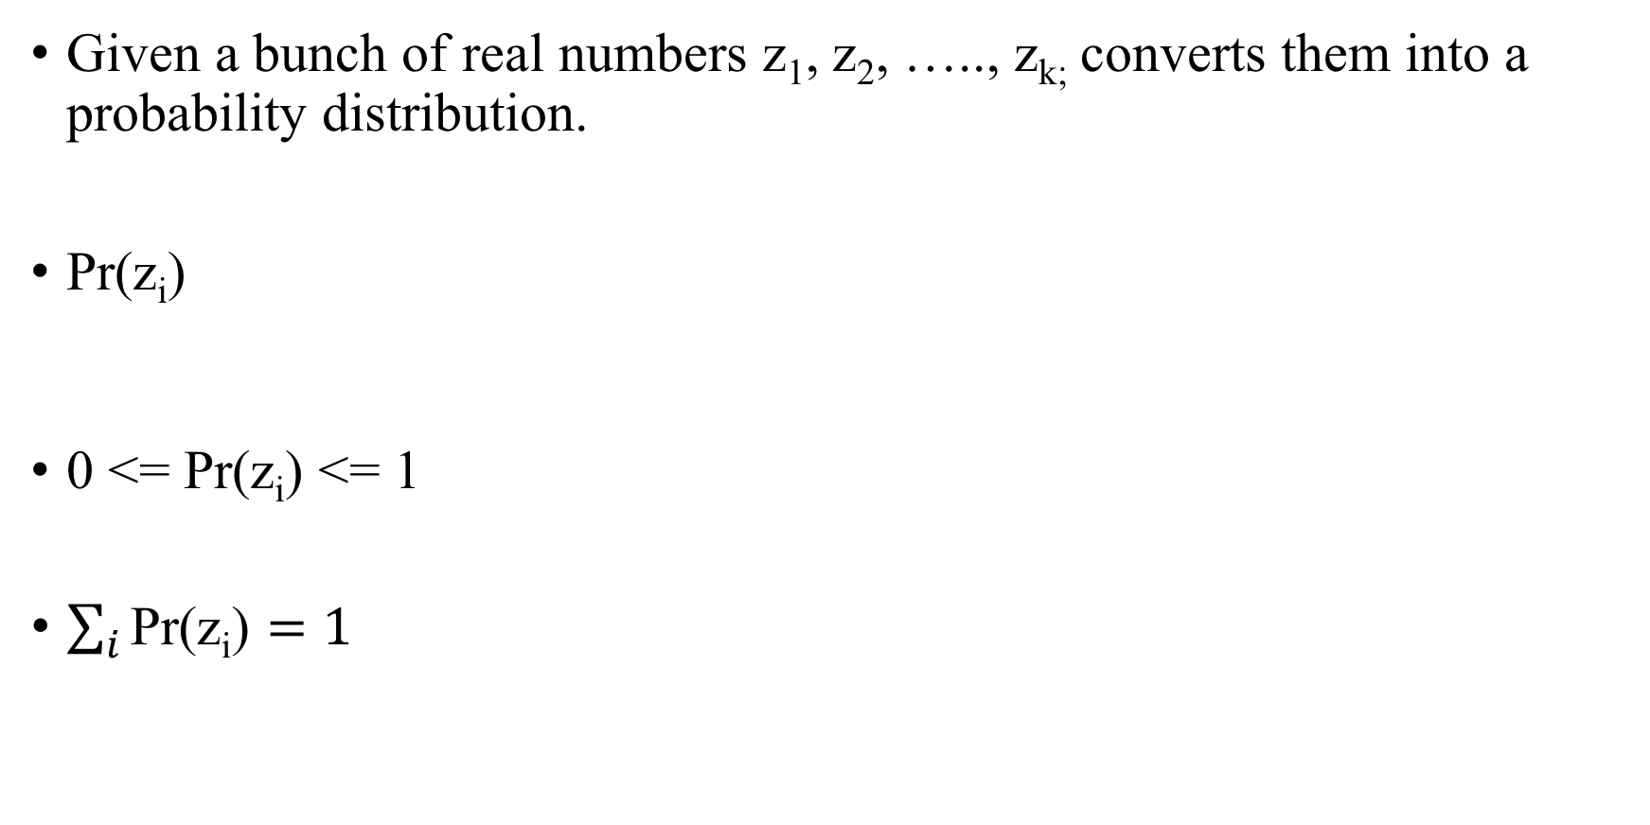
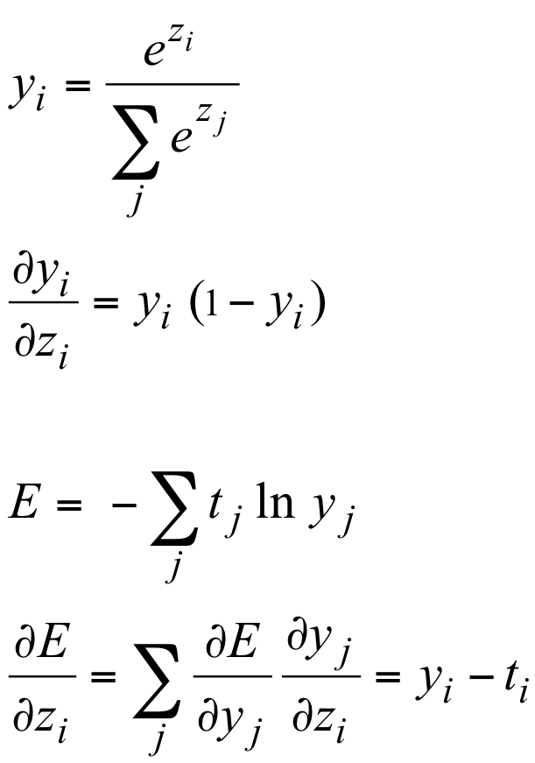
Softmax

Slide 26
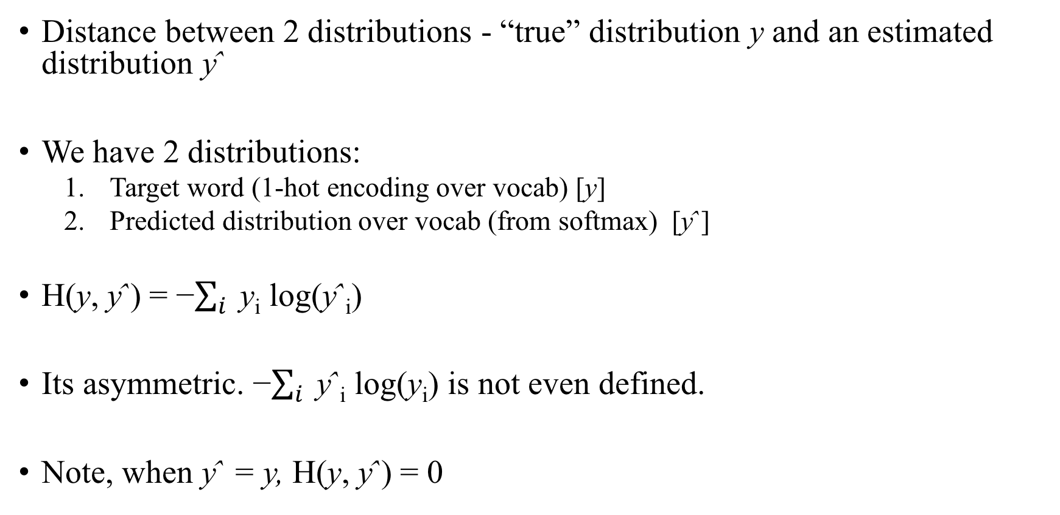
Cross Entropy

Slide 27
Remarks
Per word, we have 2 vectors :
As row in Embedding layer (E)
As column in weights layer (used for afine transformation)
It’s common to take average of the 2 vectors.
It’s common to normalise the vectors. Divide by norm.
An alternative way to compute ŷ_{i} : # (w_{i}, w_{i-1}) / # (w_{j}, w_{i-1}) ∀ j∈V
Use co-occurrence matrix to compute these counts.

Slide 28
I learn best with toy code, that I can play with. - Andrew Trask jupyter notebook 1

Slide 29

CBOW
SkipGram

Slide 30
CBOW
Continuous Bag of words.
Proposed by Mikolov et al. in 2013
Conceptually, very similar to Bi-gram model
In the bigram model, there were 2 key drawbacks:
The context was very small – we took only w_{i-1} , while predicting w_{i}
Context is not just preceding words; but following words too.

Slide 31
“the brown cat jumped over the dog”
Context = the brown cat over the dog
Target = jumped
Context window = k words on either side of the word to be predicted.
Pr (w₁, w₂, ….., w_{n}) = ∏ Pr(w_{c} | w_{c−k}, . . . , w_{c−1}, w_{c+1}, . . . , w_{c+k})
W = total number of unique windows
Each window is sliding block 2c+1 words

Slide 32
CBOW Model
Objective : given w_{c−k}, . . . , w_{c−1}, w_{c+1}, . . . , w_{c+k} , predict w_{c}
Training data: given sequence of n words < w₁, w₂, ….., w_{n} >, for each window extract context and target (w_{c−k}, . . . , w_{c−1}, w_{c+1}, . . . , w_{c+k} ; w_{c} )
Knowns:
input – output training examples : (w_{c−k}, . . . , w_{c−1}, w_{c+1}, . . . , w_{c+k} ; w_{c} )
Vocab of training corpus (V) = ∪ (w_{i})
Unknowns: word embeddings. Model as a matrix E _{|v| x d} . d = embedding dimensions. Usually a hyper parameter.

Slide 33
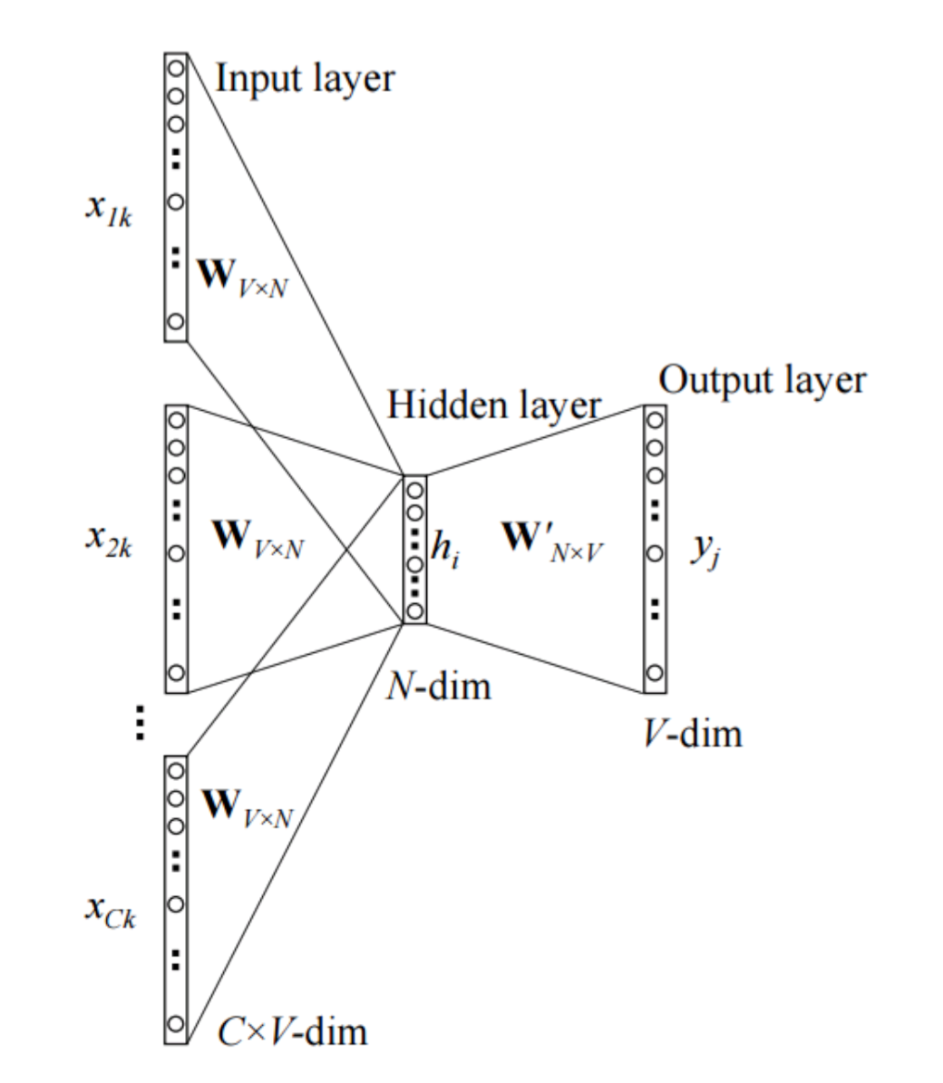
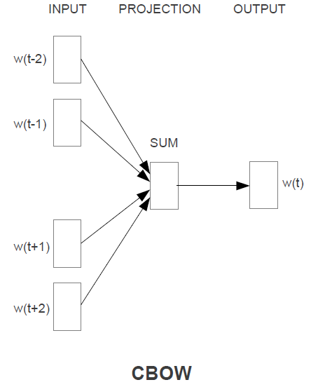
Architecture

Slide 34
Steps
Feed indexes of (x_{(c−k)} , ... , x_{(c−1)} , x_{(c+1)} , ... , x_{(c+k)}) for the input context of size k.
Use indexes to lookup embedding matrix.
Average these vectors to get vˆ = (v_{c−k}+v_{c−1}+...+v_{c+1}+v_{c+k} ) / 2m
Perform affine transform on vˆ to get a score vector.
Turn scores in probabilities for each word.
Set 1-hot vector of w_{c} as target.
Set loss = cross-entropy between probability vector and target vector.

Slide 35
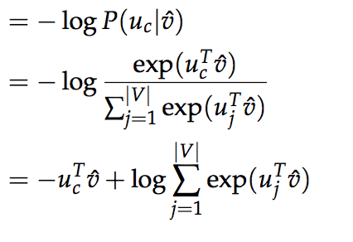
Maths behind the scene
Optimization objective J = - log Pr(w_{c} | w_{c−k}, . . . , w_{c−1}, w_{c+1}, . . . , w_{c+k})
Maximizing Pr() = Minimizing – log Pr()
Let vˆ = (w_{c−k} + . . . + w_{c−1} + w_{c+1} + . . . + w_{c+k} )/ 2m
Then, RHS
gradient descent to update all relevant word vectors u_{c} and w_{j}.

Slide 36
Skip-Gram model
2nd model proposed by Mikolov et al. in 2013
Turns CBOW over its head.
CBOW = given context, predict the target word
Skip Gram = given target, predict context
“the brown cat jumped over the dog”
Target = jumped
Context = the, brown, cat, over, the, dog

Slide 37
Objective : given w_{c} , predict w_{c−k}, . . . , w_{c−1}, w_{c+1}, . . . , w_{c+k}
Training data: given sequence of n words < w₁, w₂, ….., w_{n} >, for each window extract target and context pairs (w_{c}, w_{c−k}) , (w_{c}, w_{c−1}) , (w_{c}, w_{c+1}), (w_{c}, w_{c+k})
Knowns:
input – output training examples : (w_{c}, w_{c−k}) , (w_{c}, w_{c−1}) , (w_{c}, w_{c+1}), (w_{c}, w_{c+k})
Vocab of training corpus (V) = ∪ (w_{i})
Unknowns: word embeddings. Model as a matrix E _{|v| x d} . d = embedding dimensions. Usually a hyper parameter.

Slide 38
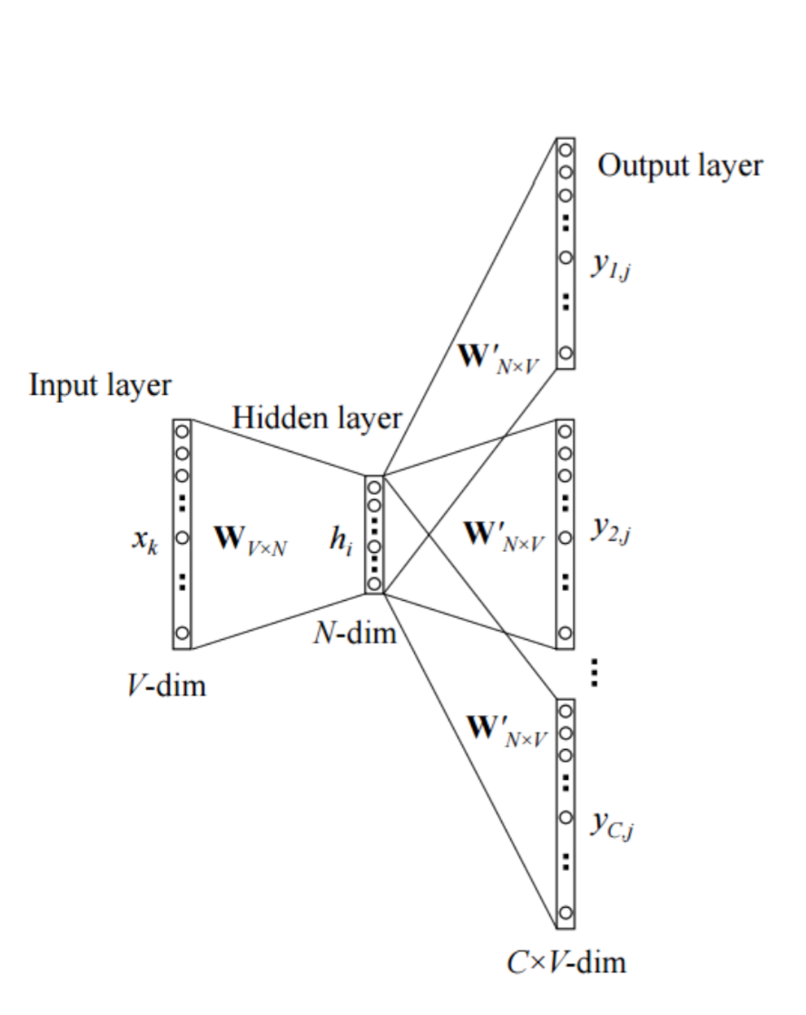
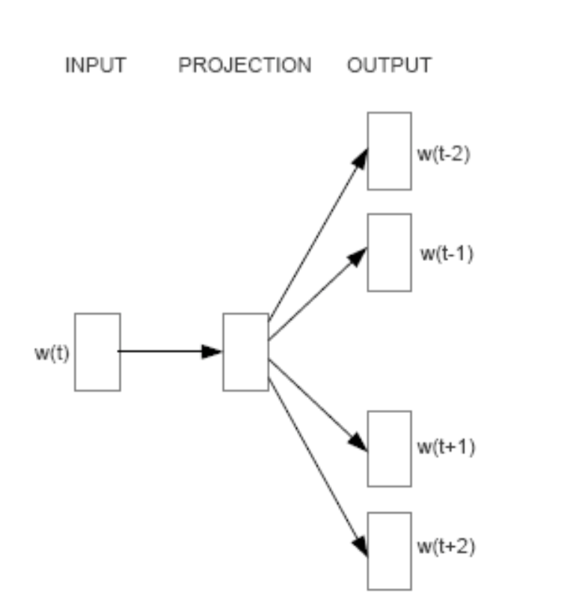
Architecture

Slide 39
Steps
Feed index of x_{c}
Use index to lookup embedding matrix.
Perform affine transform on vˆ to get a score vector.
Turn scores in probabilities for each word.
Set 1-hot vector of w_{c} as target.
Set loss = cross-entropy between probability vector and target vector.

Slide 40
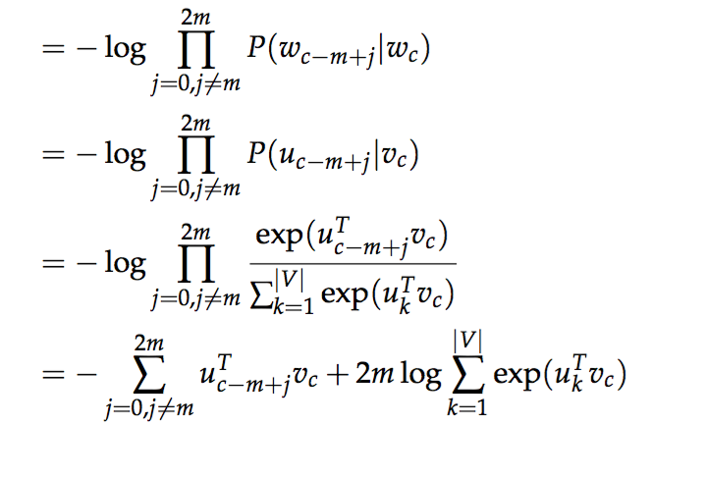
Maths behind the scene
Optimization objective J = - log Pr(w_{c−k}, . . . , w_{c−1}, w_{c+1}, . . . , w_{c+k} | , w_{c})
gradient descent to update all relevant word vectors u_{c} and w_{j}.

Slide 41
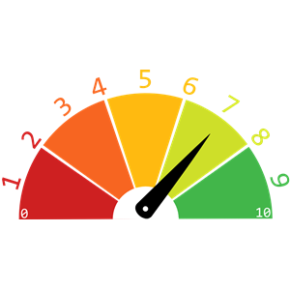
Evaluating Word vectors

Slide 42
How to quantitatively evaluate the quality of word vectors?
Intrinsic Evaluation :
Word Vector Analogies
Extrinsic Evaluation :
Downstream NLP task

Slide 43
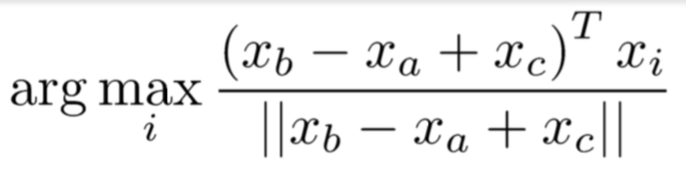
Intrinsic Evaluation
Specific Intermediate subtasks
Easy to compute.
Analogy completion:
a:b :: c:? d =
man:woman :: king:?
Evaluate word vectors by how well their cosine distance after addition captures intuitive semantic and syntactic analogy questions
Discarding the input words from the search!
Problem: What if the information is there but not linear?

Slide 44
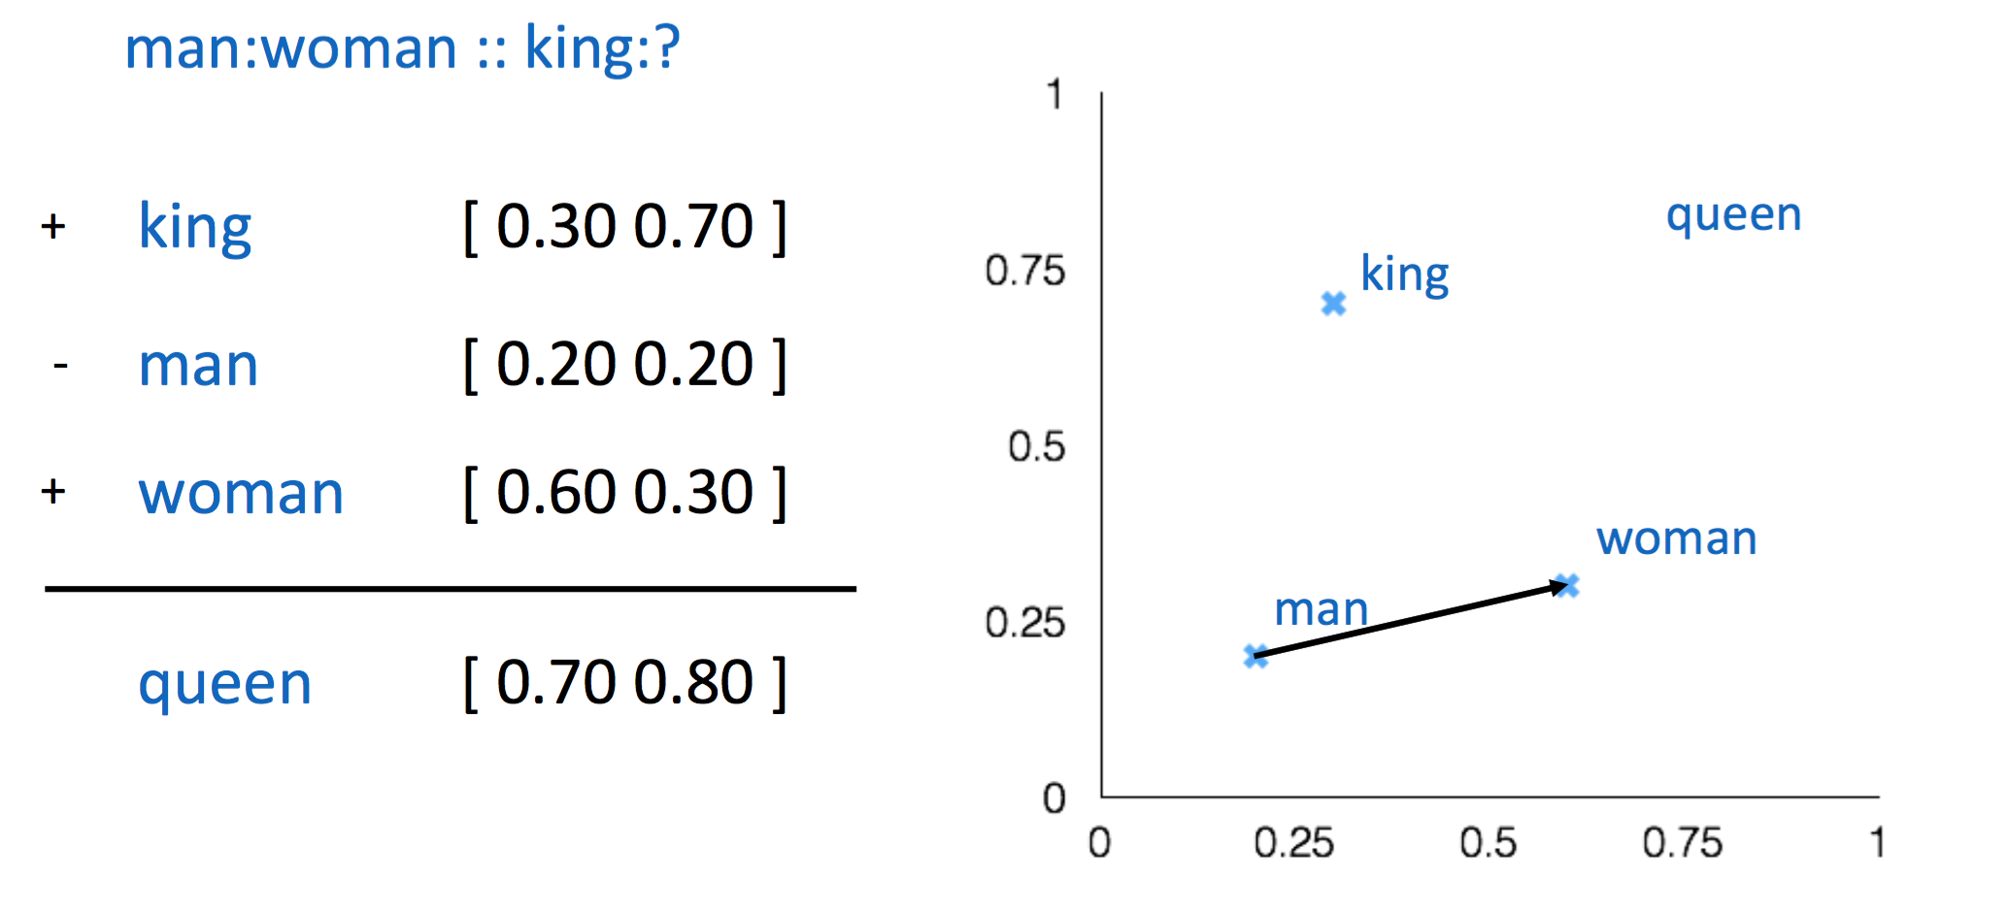

Slide 45
Extrinsic Evaluation
Real task at hand
Ex: Sentiment analysis.
Not very robust.
End result is a function of whole process and not just embeddings.
Process:
Data pipelines
Algorithm(s)
Fine tuning
Quality of dataset

Slide 46

Speed Up

Slide 47
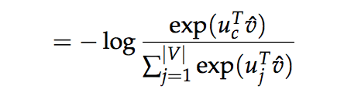
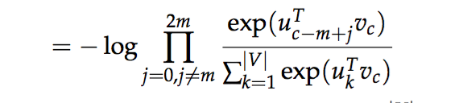
Bottleneck
Recall, to calculate probability, we use softmax. The denominator is sum across entire vocab.
Further, this is calculated for every window.
Too expensive.
Single update of parameters requires to iterate over |V|. Our vocab usually is in millions.

Slide 48
To approximate probability, dont use the entire vocab.
There are 2 popular line of attacks to achieve this:
Modify the structure the softmax
Hierarchical Softmax
Sampling techniques : don’t use entire vocabulary to compute the sum
Negative sampling

Slide 49
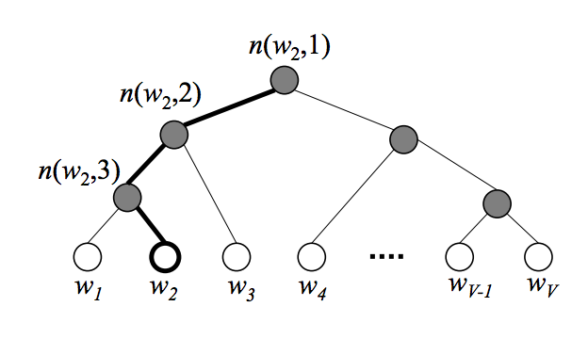
Hierarchical Softmax
Arrange words in vocab as leaf units of a balanced binary tree.
|V| leaves |V| - 1 internal nodes
Each leaf node has a unique path from root to the leaf
Probability of a word (leaf node L_{w}) = Probability of the path from root node to leaf L_{w}
No output vector representation for words, unlike softmax.
Instead every internal node has a d-dimension vector associated with it - v’_{n(w, j)}
n(w, j) means the j-th unit on the path from root to the word w

Slide 50
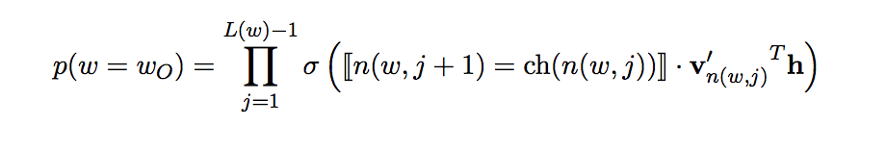
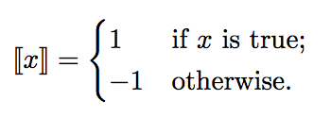
Product of probabilities over nodes in the path
Each probability is computed using sigmoid
Inside it we check : if (j+1)^{th} node on path left child of j^{th} node or not
v’_{n(w, j)}^{T} h : vector product between vector on hidden layer and vector for the inner node in consideration.

Slide 51
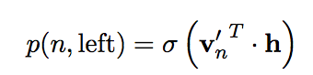
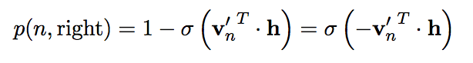
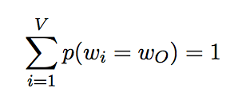
Example
p(w = w₂)
We start at root, and navigate to leaf w₂
p(w = w₂)

Slide 52
Cost: O(|V|) to O(log ⁡|V| )
In practice, use Huffman tree

Slide 53
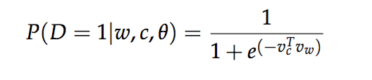
Negative Sampling
Given (w, c) : word and context
Let P(D=1|w,c) be probability that (w, c) came from the corpus data.
P(D=0|w,c) = probability that (w, c) didn’t come from the corpus data.
Lets model P(D=1|w,c) with sigmoid:
Objective function (J):
maximize P(D=1|w,c) if (w, c) is in the corpus data.
maximize P(D=0|w,c) if (w, c) is not in the corpus data.
We take a simple maximum likelihood approach of these two probabilities.

Slide 54
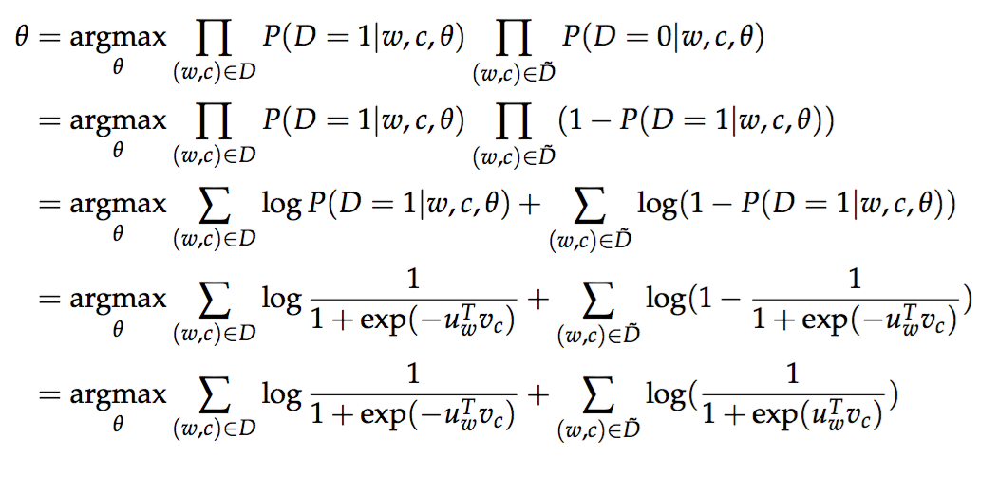
Took log on both side
θ is parameters of the model. In our case U and V - input, output word vectors.

Slide 55
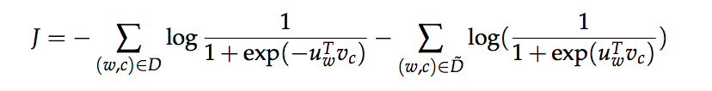
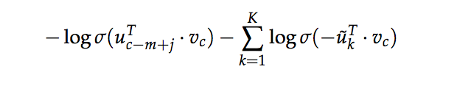
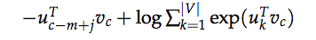
Now, maximizing log likelihood = minimizing negative log likelihood.
D ̃ is “false” or negative “Corpus” with wrong sentences - "jumped cat dog the the over"
Generate D ̃ on the fly by randomly sampling this negative from the word bank.
For skip-gram, our new objective function for observing the context word w_{c − m + j} given the center word w_{c} would be :
regular softmax loss for skip-gram

Slide 56
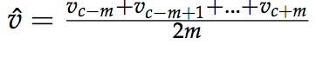
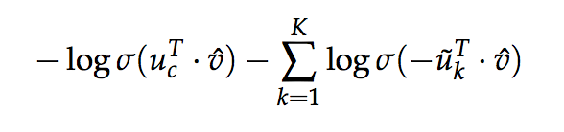
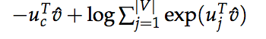
Likewise for CBOW, our new objective function for observing the center
word u_{c} given the context vector
In the above formulation, {u˜_{k} |k = 1 . . . K} are sampled from P_{n}(w).
best P_{n}(w) = Unigram distribution raised to the power of 3/4
Usually K = 20-30 works well.
regular softmax loss for CBOW

Slide 57

GloVe

Slide 58
Global matrix factorization methods
Use co-occurrence counts
Ex: LSA, HAL (Lund & Burgess), COALS (Rohde et al), Hellinger-PCA (Lebret & Collobert)
Fast training
Efficient usage of statistics
Captures word similarity
Do badly on analogy tasks
Disproportionate importance given to large counts

Slide 59
Local context window method
Use window to determine context of a word
Ex: Skip-gram/CBOW ( Mikolov et al), NNLM(Bengio et al), HLBL, (Collobert & Weston)
Capture word similarity.
Also performance better on analogy tasks
Slow down with increase in corpus size
Inefficient usage of statistics

Slide 60
Combining the best of both worlds
Glove model tries to combine the two major model families :-
Global matrix factorization (co-occurrence counts)
Local context window (context comes from window)
= Co-occurrence counts with context distance

Slide 61
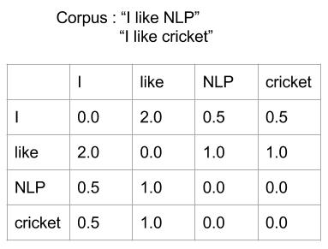
Co-occurrence counts with context distance
Uses context distance : weight each word in context window using its distance from the center word
This ensures nearby words have more influence than far off ones.
Sentence -> “I like NLP”
Co-occurrence for I -> like : 1.0 & I -> NLP : 0.5
Co-occurrence for like -> I : 1.0 & like -> NLP : 1.0
Co-occurrence for NLP -> I : 0.5 & NLP -> like : 1.0
Corpus C: I like NLP. I like cricket.
Co-occurrence matrix for C

Slide 62
Issues with Co-occurrence Matrix
Long tail distribution
Frequent words contribute disproportionately
(use weight function to fix this)
Use Log for normalization
Avoid log 0 : Add 1 to each X_{ij} X₂₁

Slide 63
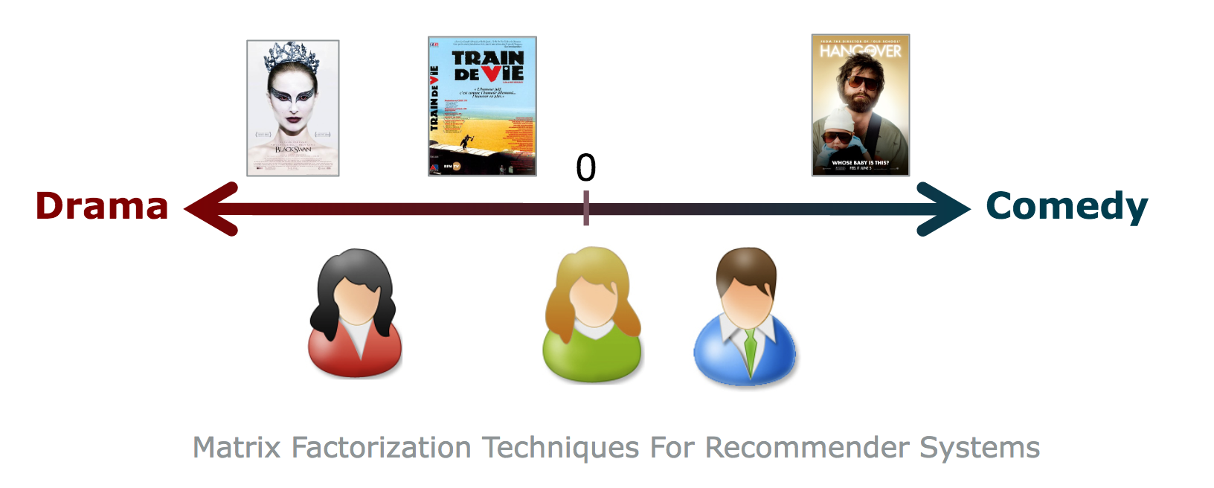
Intuition for Glove
Think of matrix factorization algorithms used in recommendation systems.
Latent Factor models
Find features that describe the characteristics of rated objects.
Item characteristics and user preferences are described using vectors which are called factor vectors
Assumption: Ratings can be inferred from a model put together from a smaller number of parameters

Slide 64
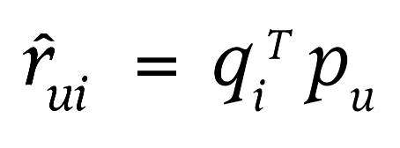
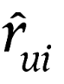
Latent Factor models
Dot product estimates user’s interest in the item
where, q_{i} : factor vector for item i.
p_{u} : factor vector for user u
_{i} : estimated user interest
How to compute vectors for items and users ?

Slide 65
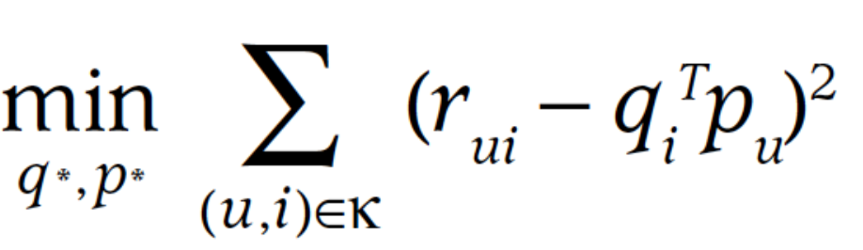
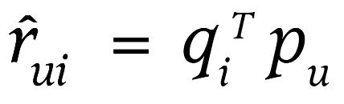
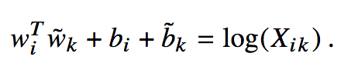
Matrix Factorization
r_{ui} : known rating of user u for item i
predicted rating :
Similarly glove model tries to model the co-occurrence counts with the following equation :

Slide 66
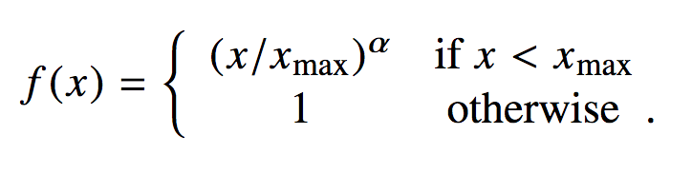
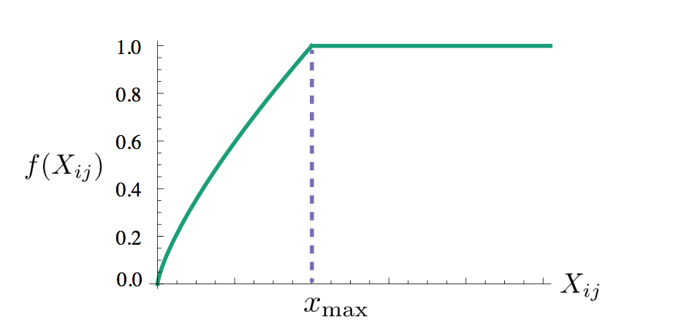
Weighting function
.
Properties of f(X)
vanish at 0 i.e. f(0) = 0
monotonically increasing
f(x) should be relatively small for large values of x
Empirically 𝞪 = 0.75, x_{max}=100 works best

Slide 67
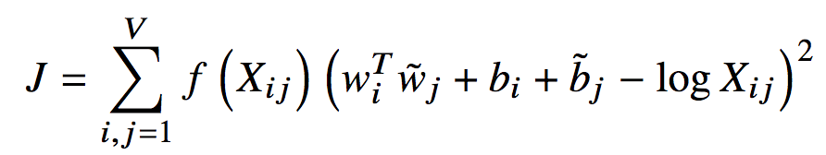
Loss Function
Scalable.
Fast training
Training time doesn’t depend on the corpus size
Always fitting to a |V| x |V| matrix.
Good performance with small corpus, and small vectors.

Slide 68
Training
Input :
X_{ij} (|V| x |V| matrix) : co-occurrence matrix
Parameters
W (|V| x |D| matrix) & W˜ (|V| x |D| matrix) :
w_{i} and w_{j}˜ representation of the i^{th} & j^{th} words from W and W˜ matrices respectively.
b_{i} (|V| x 1) column vector : variable for incorporating biases in terms
b_{j} (1 x |V|) row vector : variable for incorporating biases in terms

Slide 69
Quick Experiment
Train on Wikipedia data
|V| = 2000
Window size = 3
Iterations = 10000
D = 50
Learn two representations for each word in |V|.
reg = 0.01
Use momentum optimizer with momentum=0.9.
Takes less than 15 minutes

Slide 70
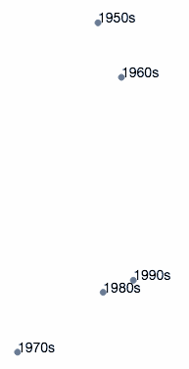


Results - months & centuries

Slide 71


Countries & languages

Slide 72

military terms

Slide 73

Music

Slide 74

Countries & Languages
Countries
Languages

Slide 75

t-SNE

Slide 76

Objective
Given a collection of N high-dimensional objects x1, x2, …. xN.
How can we get a feel for how these objects are (relatively) arranged ?

Slide 77

Introduction
Build map(low dimension) s.t. distances between points reflect “similarities” in the data :
Minimize some objective function that measures the discrepancy between similarities in the data and similarities in the map

Slide 78

Principal Components Analysis

Slide 79

Principal component analysis
PCA mainly tries to preserve large pairwise distances in the map.
Is that what we want ?

Slide 80

Goals
Preserve Distances
Preservation Neighborhood of each point

Slide 81

t-SNE High dimension
Measure pairwise similarities between high dimensional objects
x_{j}
x_{i}

Slide 82


t-SNE Lower dimension
Measure pairwise similarities between low dimensional map points

Slide 83
t-SNE
We have measure of similarity of data points in High Dimension
We have measure of similarity of data points in Low Dimension
We need a distance measure between the two.
Once we have distance measure, all we want is : to minimize it

Slide 84

One possible choice - KL divergence
It’s a measure of how one probability distribution diverges from a second expected probability distribution

Slide 85

KL divergence applied to t-SNE
Objective function (C)
We want nearby points in high-D to remain nearby in low-D
In the case it's not, then
p_{ij} will large (because points are nearby)
but q_{ij} will be small (because points are far away)
This will result in larger penalty
In contrast, If both p_{ij} and q_{ij} are large : lower penalty
Ex : Let p_{ij} = 0.8 & q_{ij} = 0.1, Loss = log(0.8/0.1) = 2.07
Let p_{ij} = 0.8 & q_{ij} = 0.7, Loss = log(0.8/0.7) = 0.13

Slide 86
KL divergence applied to t-SNE
Likewise, we want far away points in high-D to remain (relatively) far away in low-D
In the case it's not, then
p_{ij} will small (because points are far away)
but q_{ij} will be large (because points are nearby)
This will result in lower penalty
t-SNE mainly preserves local similarity structure of the data

Slide 87
t-Distributed Stochastic Neighbor Embedding
Move points around to minimize :

Slide 88
Why a Student t-Distribution ?
t-SNE tries to retain local structure of this data in the map
Result : dissimilar points have to be modelled as far apart in the map
Hinton, has showed that student t-distribution is very similar to gaussian distribution
Local structures preserved
global structure is lost
Local structures
global structure

Slide 89
Deciding the effective number of neighbours
We need to decide the radii in different parts of the space, so that we can keep the effective number of neighbours about constant.
A big radius leads to a high entropy for the distribution over neighbors of i.
A small radius leads to a low entropy.
So decide what entropy you want and then find the radius that produces that entropy.
It's easier to specify 2^{entropy}
This is called the perplexity
It is the effective number of neighbors.

Slide 90
Experiments

Slide 91

Hyper parameters really matter: Playing with perplexity
projected 100 data points clearly separated in two different clusters with tSNE
Applied tSNE with different values of perplexity
With perplexity=2, local variations in the data dominate
With perplexity in range(5-50) as suggested in paper, plots still capture some structure in the data

Slide 92

Hyper parameters really matter: Playing with #iterations
Perplexity set to 30.0
Applied tSNE with different number of iterations
Takeaway : different datasets may require different number of iterations

Slide 93

Cluster sizes can be misleading
Uses tSNE to plot two clusters with different standard deviation
bottomline, we cannot see cluster sizes in t-SNE plots

Slide 94

Distances in t-SNE plots
At lower perplexity clusters look equidistant
At perplexity=50, tSNE captures some notion of global geometry in the data
50 data points in each sub cluster

Slide 95

Distances in t-SNE plots
tSNE is not able to capture global geometry even at perplexity=50.
key take away : well separated clusters may not mean anything in tSNE.
200 data points in each sub cluster

Slide 96

Random noise doesn’t always look random
For this experiment, we generated random points from gaussian distribution
Plots with lower perplexity, showing misleading structures in the data

Slide 97

You can see some shapes sometimes
Axis aligned gaussian distribution
For certain values of perplexity, long cluster look almost correct.
tSNE tends to expands regions which are denser

Slide 98

Why word2vec does better than others ?

Slide 99
At heart they are all same !!
Its has been shown that in essence GloVe and word2vec are no different from traditional methods like PCA, LSA etc (Levy et al. 2015 call them DSM )
GloVe ⋍ PCA/LSA is straightforward (both factorize global counts matrix)
word2vec ⋍ PCA/LSA is non-trivial (Levy et al. 2015)
They show that in essence word2vec also factorizes word context matrix (PMI)

Slide 100
Despite this “equality” of algorithm, word2vec is still known to do better on several tasks.
Why ?
Levy et al. 2015 show : magic lies in Hyperparameters

Slide 101
Hyperparameters
Pre-processing
Dynamic context window
Subsampling frequent words
Deleting rare words
Post-processing
Adding context words
Vector normalization

Slide 102

Pre-processing
Dynamic Context window
In DSM, context window: unweighted & constant size.
Glove & SGNS - give more weightage to closer terms
SGNS - even the window size can be dynamic and take a value between 1 & max of windowsize.
Subsampling frequent words
SGNS dilutes frequent words by randomly removing words whose frequency f is higher than some threshold t, with probability
Deleting rare words
In SGNS, rare words are also deleted before creating context windows.
Levy et at(2015) show this didn’t have significant impact.

Slide 103

Post-processing
Adding context vectors
Glove adds word vectors and the context vectors for the final representation.
Vector normalization
All vectors can be normalized to unit length

Slide 104
Key Take Home
Hyperparameters vs Algorithms
Hyper parameter settings is more important than the algorithm choice
No single algorithm consistently outperforms the other ones
Hyperparameters vs more data
Training on larger corpus helps on some tasks
In many cases, tuning hyperparameters in more beneficial

Slide 105
References
Idea of word vectors is not new.
Learning representations by back-propagating errors (Rumelhart et al. 1986)
A neural probabilistic language model (Bengio et al., 2003)
NLP from Scratch (Collobert & Weston, 2008)
Word2Vec (Mikolov et al. 2013)
Sebastian Ruder’s 3 part Blog series
Lecture 2-4, CS 224d “Deep Learning for NLP” by Richard Socher
word2vec Parameter Learning Explained by X Rong

Slide 106
References
GloVe :
https://nlp.stanford.edu/pubs/glove.pdf
https://www.youtube.com/watch?v=tRsSi_sqXjI
http://rdipietro.github.io/friendly-intro-to-cross-entropy-loss/
https://cs224d.stanford.edu/lectures/CS224d-Lecture3.pdf
t-SNE:
http://www.jmlr.org/papers/volume9/vandermaaten08a/vandermaaten08a.pdf
http://distill.pub/2016/misread-tsne/
https://www.slideshare.net/ssuserb667a8/visualization-data-using-tsne
https://youtu.be/RJVL80Gg3lA
KL Divergence
http://tdhopper.com/blog/2015/Sep/04/cross-entropy-and-kl-divergence/

Slide 107
References
Cross Entropy :
https://www.youtube.com/watch?v=tRsSi_sqXjI
http://rdipietro.github.io/friendly-intro-to-cross-entropy-loss/
Softmax:
https://en.wikipedia.org/wiki/Softmax_function
http://cs231n.github.io/linear-classify/#softmax
Tensor Flow
1.0 API docs
CS20SI

Slide 108

https://fifthelephant.talkfunnel.com/2017/17-learning-representations-of-text-for-nlp

Slide 109
Appendix

Slide 110
Bag of Words
Vocab = set of all the words in corpus
Document = Words in document w.r.t vocab with multiplicity
Sentence 1: "The cat sat on the hat"
Sentence 2: "The dog ate the cat and the hat”
Vocab = { the, cat, sat, on, hat, dog, ate, and }
Sentence 1: { 2, 1, 1, 1, 1, 0, 0, 0 }
Sentence 2 : { 3, 1, 0, 0, 1, 1, 1, 1}

Slide 111
Pros & Cons
+ Quick and Simple
Too simple
Orderless
No notion of syntactic/semantic similarity

Slide 112
N-gram model
Vocab = set of all n-grams in corpus
Document = n-grams in document w.r.t vocab with multiplicity
For bigram:
Sentence 1: "The cat sat on the hat"
Sentence 2: "The dog ate the cat and the hat”
Vocab = { the cat, cat sat, sat on, on the, the hat, the dog, dog ate, ate the, cat and, and the}
Sentence 1: { 1, 1, 1, 1, 1, 0, 0, 0, 0, 0}
Sentence 2 : { 1, 0, 0, 0, 0, 1, 1, 1, 1, 1}

Slide 113
Pros & Cons
+ Tries to incorporate order of words
Very large vocab set
No notion of syntactic/semantic similarity

Slide 114
Term Frequency–Inverse Document Frequency (TF-IDF)
Captures importance of a word to a document in a corpus.
Importance increases proportionally to the number of times a word appears in the document; but is offset by the frequency of the word in the corpus.
TF(t) = (Number of times term t appears in a document) / (Total number of terms in the document).
IDF(t) = log (Total number of documents / Number of documents with term t in it).
TF-IDF (t) = TF(t) * IDF(t)

Slide 115
Example
Document D1 contains 100 words.
cat appears 3 times in D1
TF(cat) = 3 / 100
= 0.3
Corpus contains 10 million documents
cat appears in 1000 documents
IDF(cat) = log (10,000,000 / 1,000)
= 4
TF-IDF (cat) = 0.3 * 4

Slide 116
Pros & Cons
Pros:
Easy to compute
Has some basic metric to extract the most descriptive terms in a document
Thus, can easily compute the similarity between 2 documents using it
Disadvantages:
Based on the bag-of-words (BoW) model, therefore it does not capture position in text, semantics, co-occurrences in different documents, etc.
Thus, TF-IDF is only useful as a lexical level feature. (presence/absense)
Cannot capture semantics (unlike topic models, word embeddings)

Slide 117
Positive Pointwise Mutual Information (PPMI): PMI is a common measure for the strength of association between two words. It is defined as the log ratio between the joint probability of two words ww and cc and the product of their marginal probabilities:
PMI(w,c)=logP(w,c)/P(w)P(c)
PPMI(w, c) = max(PMI(w,c), 0)

